Slide 1

April 2025

Slide 2
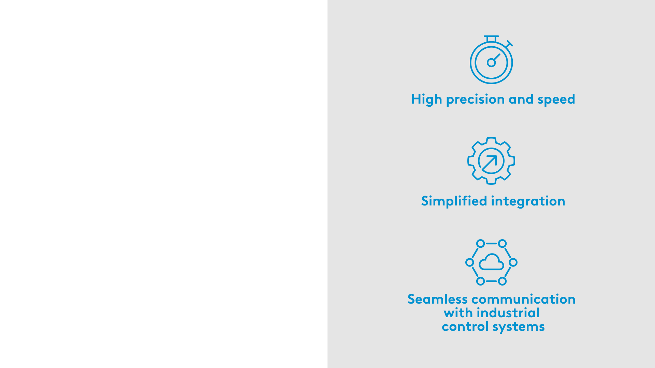

Introducing the WT Series –
Weight Transmitters
Reliable weight measurement and visibility,
made simple
Convert load cell signals into accurate weight values in real time
Display actionable weight information where it’s needed
2 | WT Series Presentation | May 2026

Slide 3
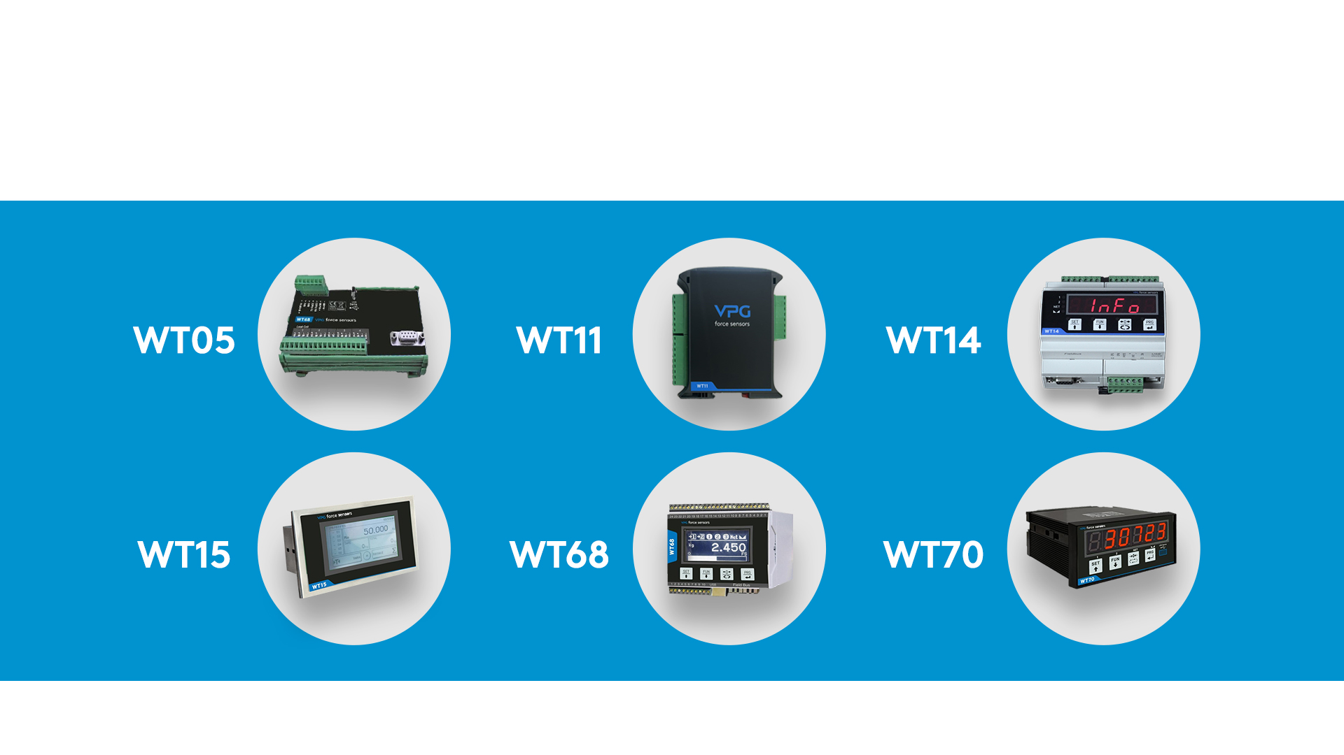
WT Product Range
3 | WT Series Presentation | May 2026

Slide 4
Highlights
Versatile, quality-engineered weight transmitters for process weighing
Unified language – one HW/SW interface to learn, easy scalability
Compact and lightweight designs – easy installation
High-performing A/D converter – fast data transmission and conversion
PC-based setup, calibration and monitoring – simplified access from anywhere
A complete measurement solution – Load cells + weight transmitter + accessories from 1 supplier
UL Certified , CE , OIMLR76 ( WT14,15 )
4 | WT Series Presentation | May 2026

Slide 5



Key benefits
Engineered for precision, built for reliability
Complete, single-source solution
From the leader in precision weighing solutions
Highly accurate and durable – Proven in tough industrial environments
Versatile connectivity – Support for varied communications, compatible with any PLC
Fast & simple configuration – VPG optimization tool
Standart software – Varied applications, reduced learning curve
Weight transmitters, load cells, and accessories
Straightforward and assured integration – All components are proven to work together
Simplified purchasing – One order, with fast delivery
Professional support & training – Across the full solution
60+ years of innovation – Pioneers in strain gage-based weighing and force measurement
Proven high-quality – Reliable, durable products engineered for consistent accuracy
Dependable global supply – Stable, long-term availability from an established global provider
5 | WT Series Presentation | May 2026

Slide 6

WT11 Weight Transmitter
Small in size, big in capabilities
Ultra-slim, lightweight design
Easy DIN rail installation
Fast data acquisition & conversion
High-performance A/D converter
Supports fieldbus and analog output protocols.
Gross/Net/Peak modes ,Auto‑tare & semi‑automatic zero, Weight (Hold)
Optional Alibi memory (1 MB)
Includes digital inputs / outputs
PC-based calibration and monitoring
Mechanical keyboard with programmable keys
Removable screw terminal blocks
USB port for firmware update
6 | WT Series Presentation | May 2026

Slide 7


WT11 Key applications
Process Weighing
Including:
Silo Weighing ( e.g Load cell models 65023 , 65043 )
Inventory monitoring
Remote monitoring
Static applications
Test & Measurement ,Production testing (EOL,QA)
Including:
Steering wheels force/torque
Tires performance forces
Servo actuator testing
Easy DIN, slim
Inside the cabinet / Rack
No need for visualization
7 | WT Series Presentation | May 2026

Slide 8

WT11 Technical details
Measuring range: 7.6 ÷ 7.6 mV/V
Display: 6 digits; 7-segment LED - red; height - 8 mm
A/D Converter: 24 bit
Excitation voltage: 4 Vdc (max 4 350 Ω LCs)
Logic input: 2 opto-isolated inputs 24 Vdc PNP (external power supply)
Serial port: 1 USB-C device + 1 RS232C and 1 RS485 with ASCII or Modbus RTU protocol or 1 Fieldbus
Temperature drift analog output: 0,002% FS/°C
Power supply: 24 Vdc ±10% 5W
2 programmable setpoints + programmable threshold behavior on outputs
Built‑in diagnostics: RS232/RS485 test, Analog output test, I/O test
8 | WT Series Presentation | May 2026

Slide 9
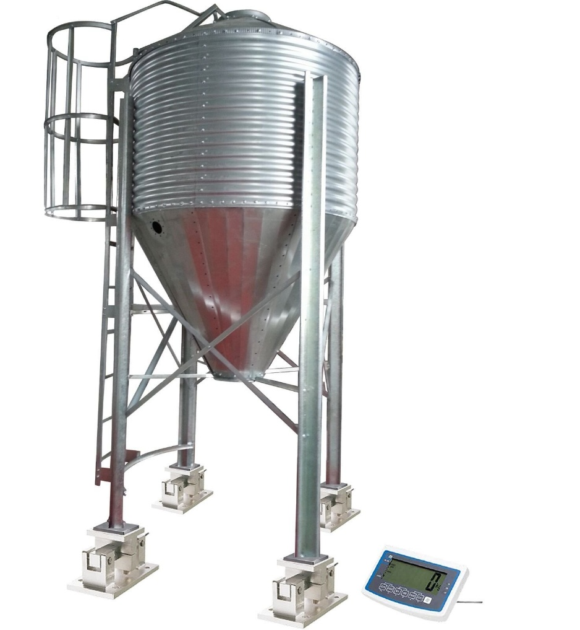
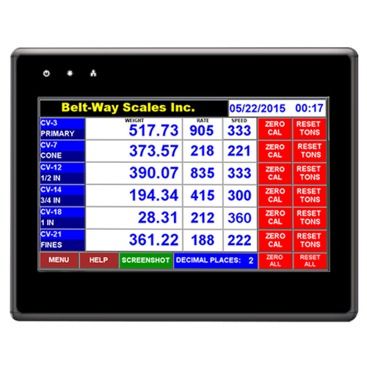
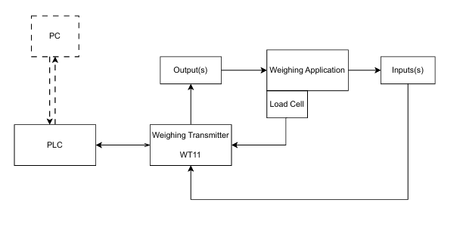
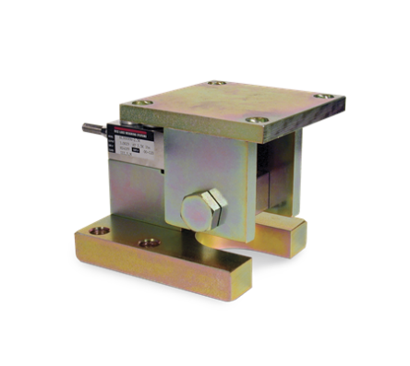
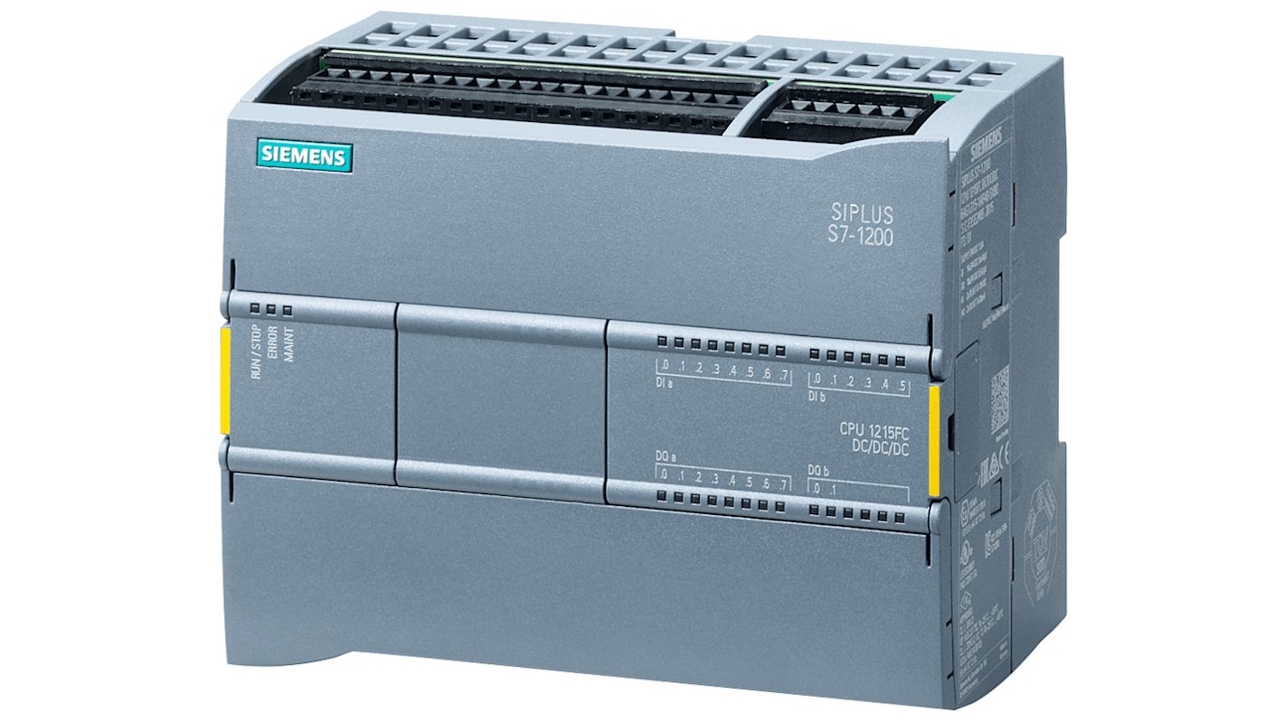
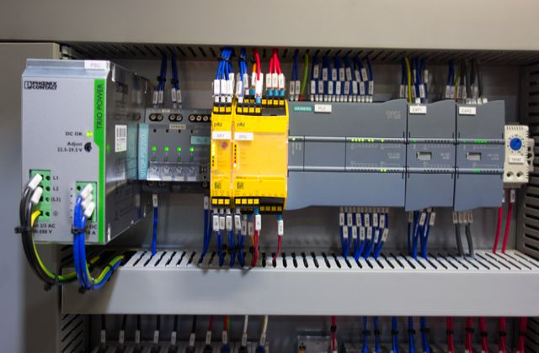
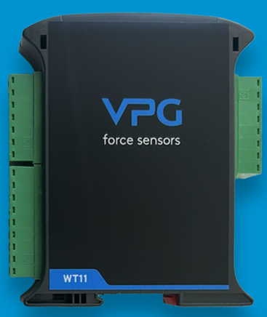
General Block Diagram
HMI
Relay control
Silo Weighing
Trigger
Field bus
mV/V
Cabinet
9 | WT Series Presentation | May 2026

Slide 10

WT14 Weight Transmitter
High-speed performance for demanding applications
Ultra-fast data acquisition, conversion and transmission
Versatile configuration
PC-based calibration and monitoring
Built for hazardous areas – Intrinsically interfaces with safety barriers
Legal for trade available
Frequency acquisition AC/DC signal up to 1000 Hz
Joint fieldbus and analog output protocol installation
Removable terminal blocks
10 | WT Series Presentation | May 2026

Slide 11

WT14 Key applications
Good response time
Hopper / batch dosing
  Tighter cut-off, less pre-act correction
Loss-in-weight feeding
  Stable fast improve control loop stability
Drum / container filling on conveyor
  Shorter dwell time, better throughput, setpoint timing handles cut-off
High-throughput platform / floor scales
  Cycle rate, not dynamic load; go/no-go via two setpoints
Check weighing
  Fast pass/fail, packaging, bagging, tanks
Legal-for-trade with speed requirement
  OIML R76 + fast response in a DIN-rail package, more cost-effective than the WT15 for this use case
11 | WT Series Presentation | May 2026

Slide 12
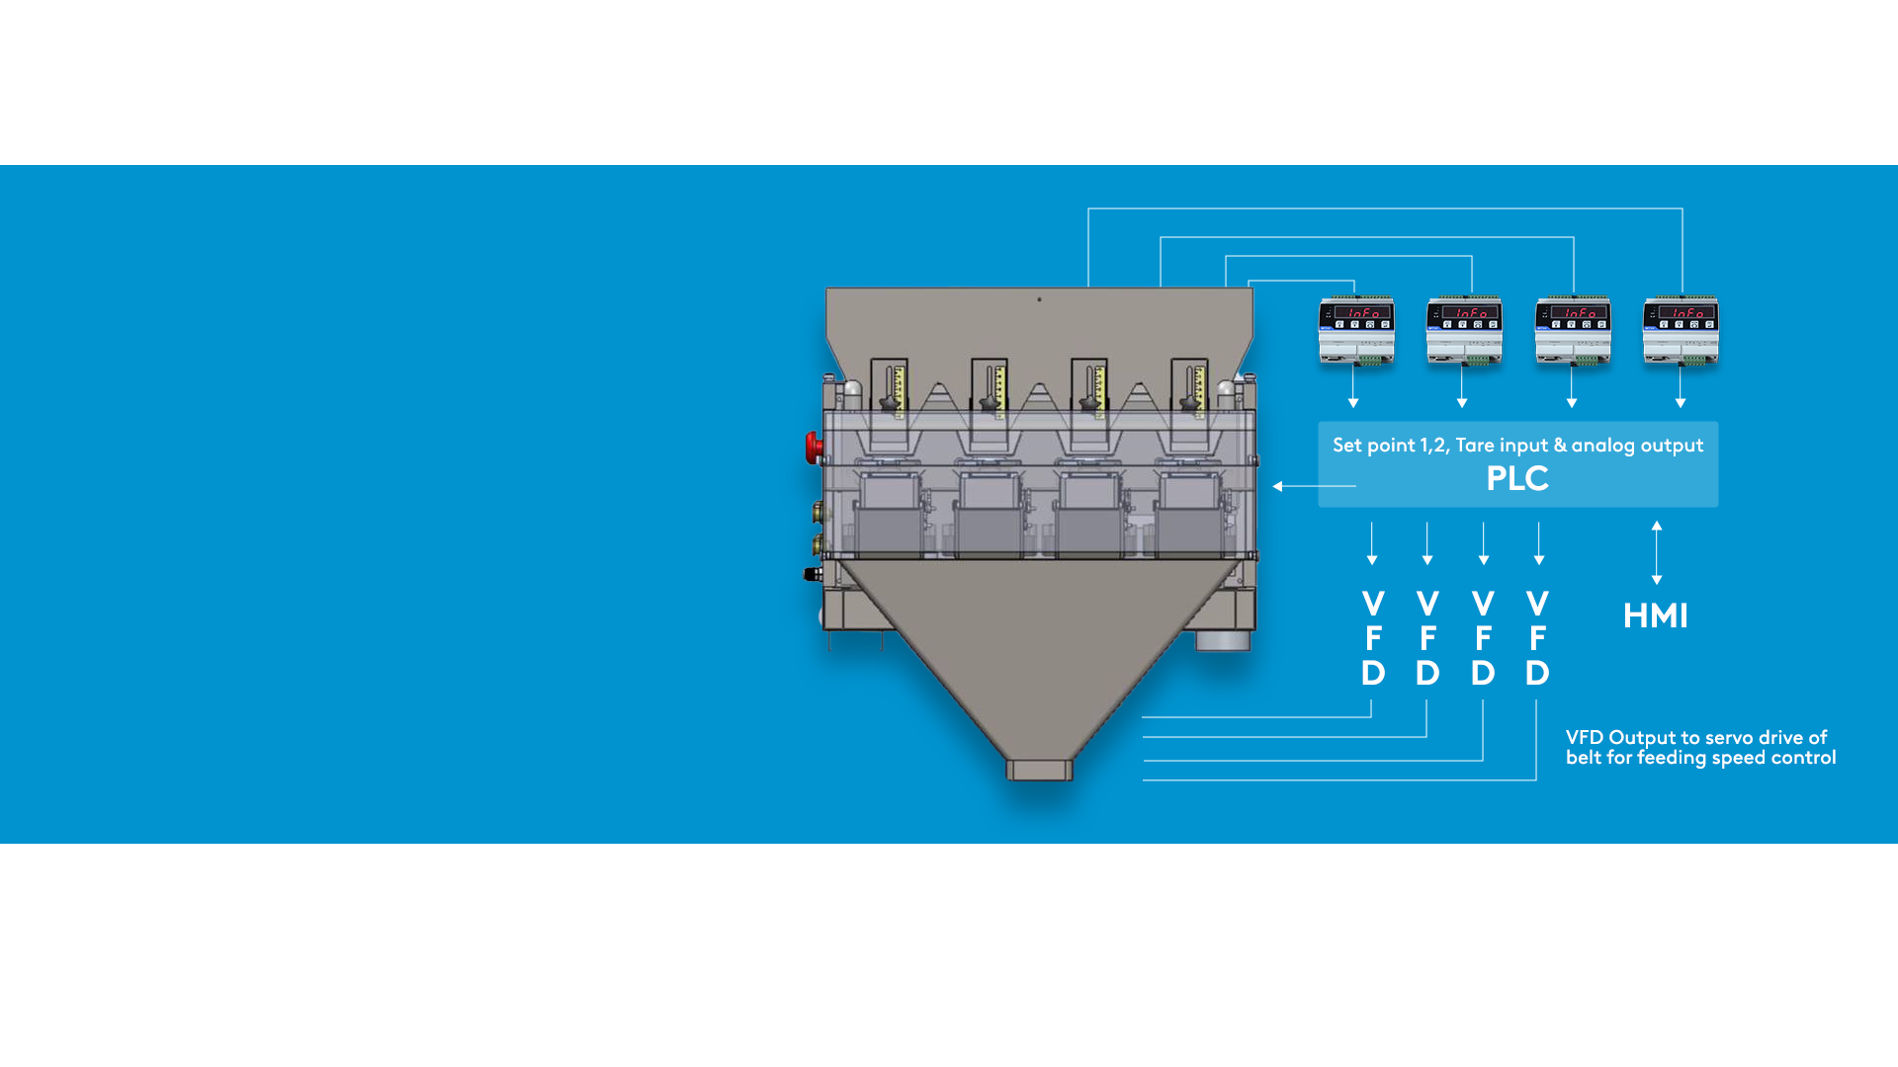
WT14
Application example
High-speed filling system layout
12 | WT Series Presentation | May 2026

Slide 13

WT14 Technical details
Measuring range: -3.9 ÷+3.9 mV/V
Display: 6 digit, 7-segment LED red, height 14mm
A/D Converter: 24 bit
Excitation voltage: 5 Vdc (max 8 -350ΩLCs)
Logic output: 2 opto-isolated outputs; max 24Vdc/100 mA each
Logic input: 2 opto-isolated inputs 24 Vdc PNP
Serial port: 1 USB device + 1 RS232C + 1 RS485/ Fieldbus; ASCII or Modbus RTU protocol
Temperature drift analog output: 0.001% FS / °C
Power supply: 12 ÷24 Vdc ±15% 5W
13 | WT Series Presentation | May 2026

Slide 14

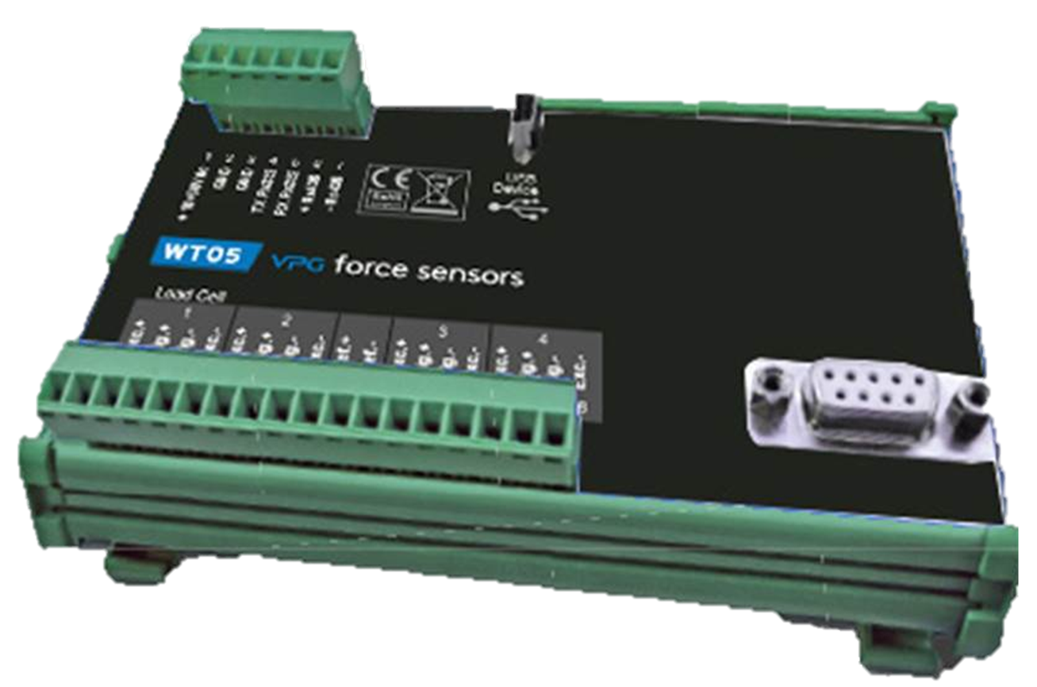
WT05 Weight Transmitter
Smart load cell junction box for reliable industrial weighing systems
Suitable for use in any industrial weighing system
Supports up to 8 LCs( multichannel , no JBOX required )
Field and remote fault diagnostics and automatic recalibration of new LCs.
Configurable via dedicated PC software or directly from the Master.
VTW Connect software for enhanced configuration and management.
Removable terminal blocks for convenient electrical connections
14 | WT Series Presentation May 2026

Slide 15
WT05 Technical details
Transducer input voltage: 5 Vcc (max 16 load cells 350Ω)
Measuring range: -3.9 mV/V ÷ +3.9 mV/V
Input sensitivity: 0.02 μV min
Output linearity: < 0.01% FS
Gain drift: < 0.0003% FS / °C
A/D Converter: 24 bit
Internal Resolution: > 8,000,000 divisions
Frequency signal acquisition: 25 ÷ 400 Hz (4 load cells)
Filter: Selectable from 0.25 Hz to 25 Hz
Power supply: 12-24 Vcc ± 15% - Power 3 W
Isolation: Class III
Installation category: Cat. II
Temperature range: -10 / +50 °C
Serial port: 1 USB device + 1 RS232C + 1 RS485
Microcontroller: 32bit ARM Cortex M0+, 128KB flash,reprogrammable on- board from USB
Data storage: 4 Kbytes
Electrical connection: Removable screw terminal, 3.81mm pitch
Dimensions: 98 x 90 x 40 mm (L x H x D)
Mounting type: Fixing with 4 screws or on support for DIN bar or OMEGA bar
15 | WT Series Presentation | May 2026

Slide 16
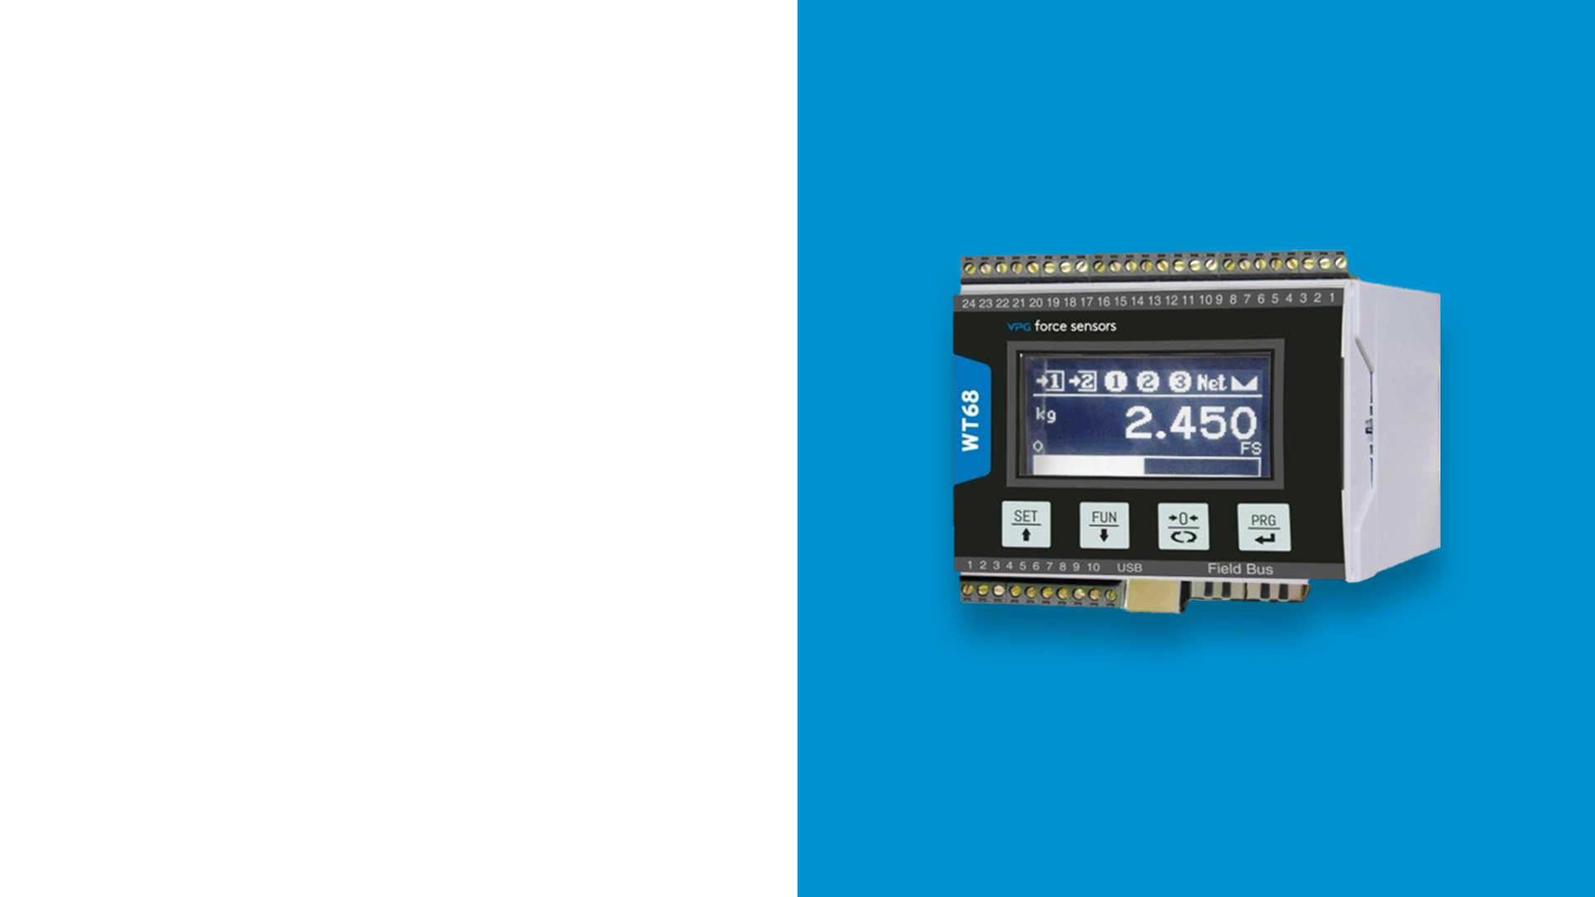
WT68 Weight Transmitter
Advanced digital weight transmitter for multi-channel industrial applications
Unique product & Ideal for all industrial applications
Easy to install and mount on DIN rail.
Advanced technology for weighing and measuring systems.
Converts the mV signal to a high-resolution digital signal (24 bit)
Displays up to 8 channels separately.
Integrates as a slave in various network types.
Supports various serial communication protocols or Fieldbus.
Removable screw terminal blocks
VTW Connect Software utility
16 | WT Series Presentation May 2026

Slide 17
WT68 Technical details
Measuring range: -3.9 ÷ +3.9 mV/V
Input sensitivity: 0.02 μV/count
Full scale non-Linearity: <0.01%
Gain drift: < 0.001% FS/°C
Display: 128 x 64-pixel graphic LCD
A/D Converter: 24 bits
Internal Resolution: > 16.000.000 points
Transducer input voltage: 5 Vdc (max. 230 mA)
Frequency signal acquisition: 12.5 ÷ 300 Hz
Visible resolution (in divisions): 999999 divisions
Divisions value (adjustable): x1, x2, x5, x10, x20, x50
Decimal figures range: 0 ÷ 4
Temperature range: -10 ÷ + 50°C
Storage temperature: -20 ÷ +70°C
Filter: 5 ÷ 250 Hz
Logic output: 2 relays, Max. 48 VAC/VDC, 2A
Logic input: 2 op to-isolated at 12/24 Vdc PNP
Serial port: 1 USB de vice + 1 RS232C + 1 RS485 ,
Fieldbus, ASCII or Modbus RTU
Analog output Non-Linearity: < 0,02%
Temperature drift analog output: 0 ,001% FS/°C
Power supply: 12-24 Vdc ±15% - Power consumption 4 W
Microcontroller: ARM Cortex M0+ at 32 bits 256KB flash, reprogrammable on-board from USB
Data storage: 64 Kbytes expandable up to 1024 Kbytes
Number of load cells: 1 ÷ 8
Dimensions: 100 x 75 x 110 mm (L x H x P )
17 | WT Series Presentation | May 2026

Slide 18
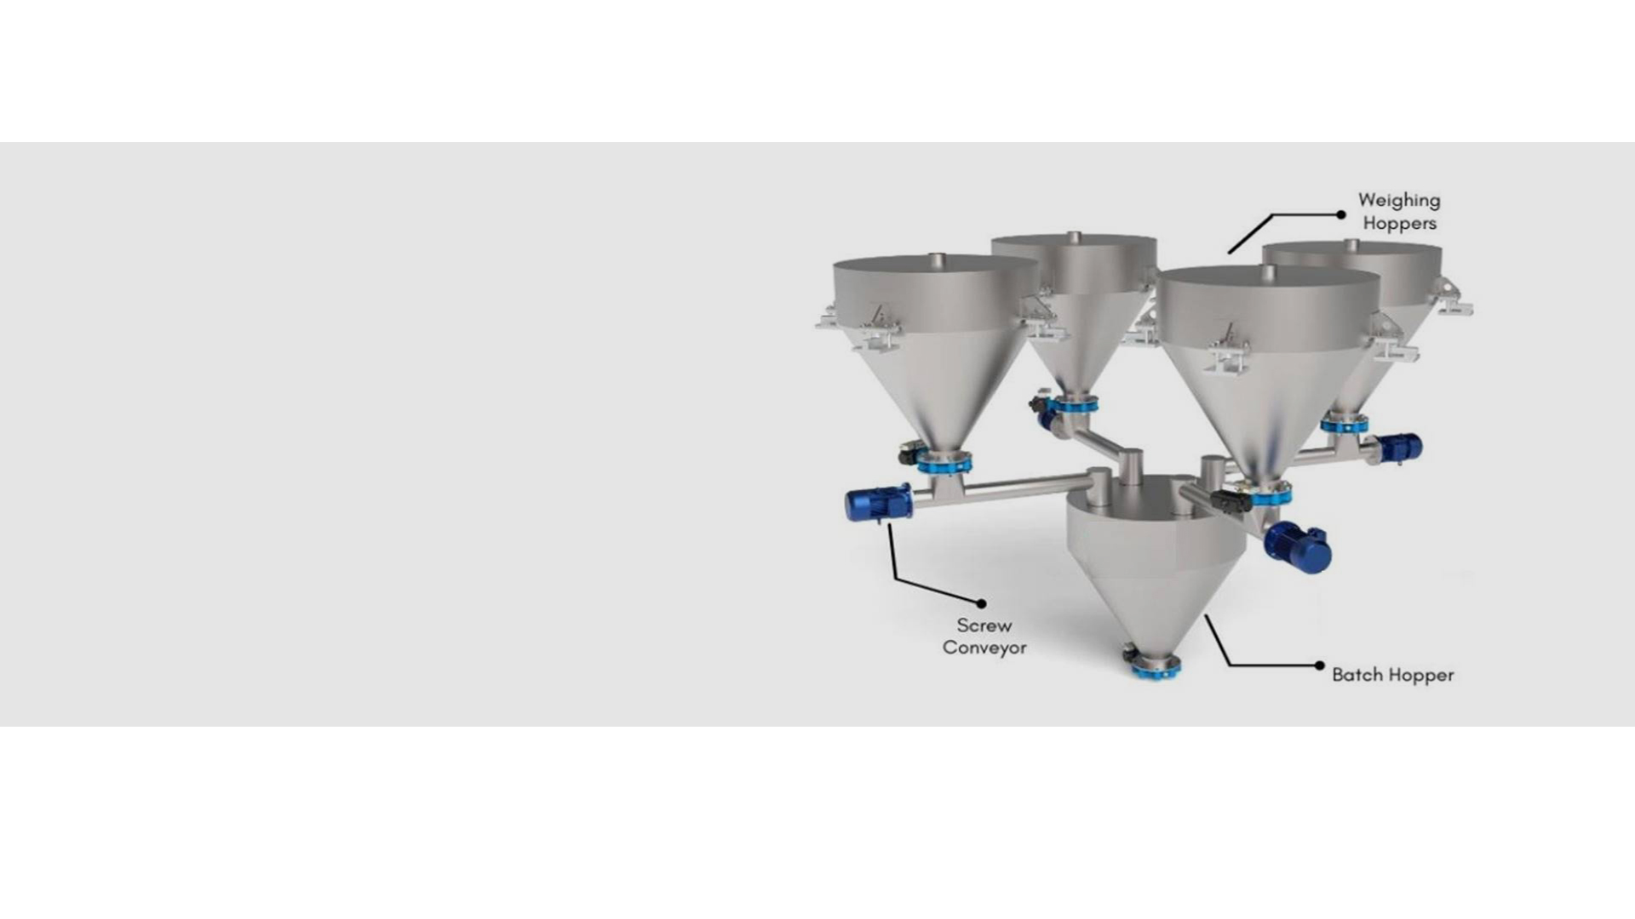
WT05/WT68
Application example
Weighing hoppers
4Channel application
18 | WT Series Presentation | May 2026

Slide 19

WT05/WT68
Application example
Batching
Up to 8 components batching
19 | WT Series Presentation | May 2026

Slide 20
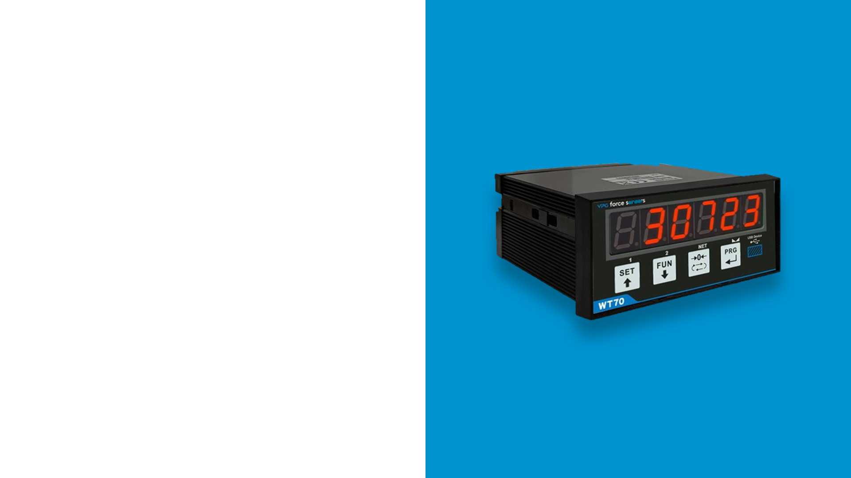
WT70 Weight Transmitter
Compact digital transmitter for accurate and connected weighing applications
Compact and practical design
Reliable performance
Real-time filtering
Available in serial and/or analog versions
Various fieldbus interfaces available
Supports analog load cells and load cells with amplified voltage/current
USB port for convenient firmware updates
VTW Connect software for enhanced configuration and monitoring
20 | WT Series Presentation | May 2026

Slide 21
WT70 Technical details
Power supply: 10-30VDC protected against reverse polarity.
Protection with resettable fuse
Insulation: Class II
Operating temperature: -10°C ± +40°C (max. non-condensing humidity 85%)
Display: numerical 6-digit red 7-segment led (h 14 mm)
Dimensions: 96 mm x 48 mm x 100 mm (w x h x d) (terminal blocks included)
Material: self-extinguishing PPO (UL 94 V0)
Electrical connection: removable screw 5.08 mm pitch terminal blocks
Cell input: max 8 of 350 ohms in parallel
Operating voltage: 5Vdc (cell input), ± 10 V / ± 5 V (analog voltage output), 0 ± 20 mA / 4 ± 20 mA (current analog output)
Output linearity: < 0.01% of full scale (cell input)
Temperature drift (Input): < 0.001% of full scale / C°
Internal Resolution: 24 bits (cell input), 16 bits
Measuring range: from -7.6 mV/V to +7.6 mV/V
Filter: selectable 0.1 Hz - 1000 Hz
Decimal figures range: 0 - 4 decimal digits
Logic output: 2 photo relay outputs (24 VDC/VAC)
Logic input: No. 2 Opto-isolated
Serial port: RS232 half duplex, RS485 half-duplex, USB Device
Baud rate: Up to 115 kb/s (default 9600 b/s)
Calibration: Digital from buttons (both current and analog voltage output)
Impedance: minimum 10K Ohm (current analog output),
maximum 300 Ohm (analog voltage output)
Microcontroller: 32-bit ARM Cortex M0+, 256KB Flash, reprogrammable on-board by USB
Data storage: 32 Kbytes + optional Alibi memory (1MByte)
21 | WT Series Presentation May 2026

Slide 22
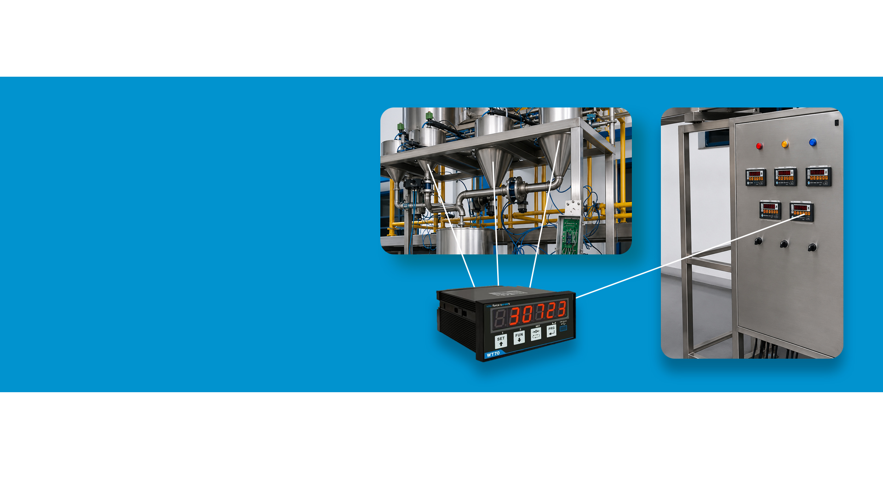
WT70
Application example
Batching
Tank weighing
22 | WT Series Presentation | April 2025

Slide 23

WT15 Weight Transmitter
Multilingual touchscreen indicator for accurate and efficient weighing control
LCD screen with capacitive touch controls
Appropriate for desk, wall or panel mounting
Multilingual menu
6 opto-isolated input and output ports
Powerful 32-bit ARM microprocessor
23 | WT Series Presentation | May 2026

Slide 24
WT15 Technical details
Legal for Trade: certification available on request
Measuring range: -3.9 ÷ +3.9 mV/V
Input sensitivity: 0.02 μV/count
Full scale non-Linearity: <0.01 % full scale
Gain drift: < 0.001% FS/°C
Display: graphic LCD (240x128 pixel)
A/D Converter: 24 bit; internal resolution up to 16.000.000
Transducer input voltage: 5 Vdc (max 8 cells -350 Ohm)
Frequency signal acquisition: 12 ÷ 1000 Hz
Visible resolution (in divisions): 999999 divisions
Divisions value (adjustable): x1, x2, x5, x10, x20, x50; max 4 decimals
Temperature range: -10 ÷ + 50°C
Filter: 0.1 ÷ 250 Hz
Logic output: 6 opto-isolated; max 24 Vdc/100mA
Logic input: 6 optically isolated 24 Vdc PNP
Additional I/O: Up to 4 external modules with 4 in/8-out each
Serial port: 1 USB device + 1 RS232C + 1 RS485/ Fieldbus
Power supply: 18 ÷ 30 Vdc - Power consumption 5 W
Microcontroller: ARM Cortex M0+ 32bit, 256KB flash, reprogrammable onboard from USB
reprogrammable onboard from USB
Data storage: 64 Kbytes expandable up to 1024 Kbytes
Drilling template: 138 x 82 mm (L x H)
Dimensions: 150x95x26mm (LxWxH) including
terminal blocks; 150x95x56mm (WxHxD) with fieldbus options
Fieldbus: Ethernet 10/100 with TCP protocol
MODUBUS/TCP, UDP, IP, ICMP, ARP; Profinet; Ethernet/IP; EtherCat
24 | WT Series Presentation | May 2026

Slide 25
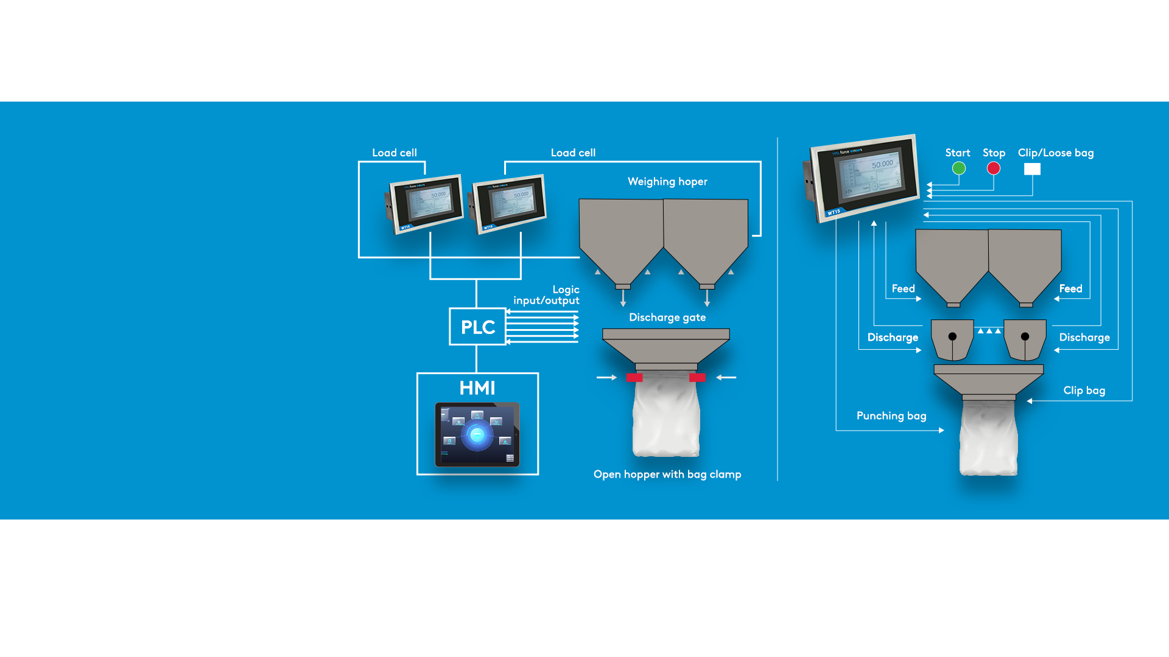
WT15
Application example
Bagging machine
Single/Dual channel
25 | WT Series Presentation | May 2026

Slide 26

WT15 Key applications
Batching , Packaging
Including:
Belt weighing
Batching Dosing ( A+B , A or B )
Automatic bagging (single and dual channel)
Big bag filling
Concrete batching / recipe multi-component
Loss-in-weight dosing (A+B dual channel)
Check weighing on a conveyor with operator intervention
26 | WT Series Presentation | May 2026

Slide 27
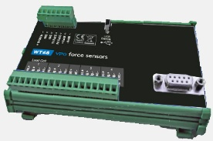
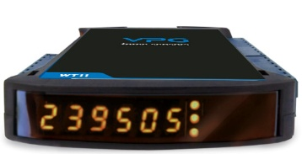
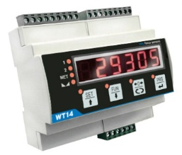
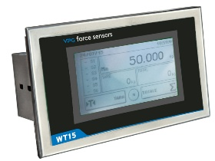
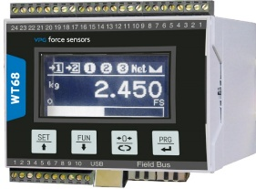
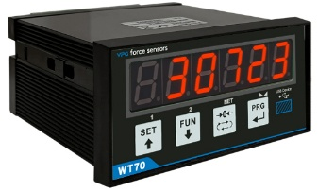
Application ↔ WT Product Matrix
Feature | WT05 | WT11 | WT14 | WT15 | WT68 | WT70
WT05 / WT68
WT05 - Larger vessel systems ,supports up to 16 load cells, fault diagnostics + emulation/ exclusion of faulty cells, good for remote diagnostics, DIN Rail, cabinet, no display, Multi-channel, no junction box required.
WT68 - Best for inventory monitoring & multi-cell behavior, multi‑channel (up to 8 channels displayed separately), DIN Rail, cabinet-integrated designed to monitor load distribution and generate alarms (drift/ missing/ failure/ unbalance), Graphic LCD 128×64 px + 4 membrane keys, multi-channel, no junction box required.
WT11 / WT14 / WT70
WT11 - General-purpose node for PLC connectivity, DIN Rail, cabinet-integrated, network access/ diagnostics/ commissioning over Ethernet, Industrial communications flexibility, Basic display for calibration.
WT14 - Fast response time, fieldbus options,12–1000 Hz signal acquisition, DIN rail, 7 SEG display + keypad.
WT70 - General-purpose node for PLC connectivity, compact panel-mounted transmitter for industrial systems requiring a local front display + simple operator access 7 SEG display + keypad .
WT15
Good for batching , packaging, multiple applications support via firmware update, Graphic LCD , 240×128 px (display)
resistive touchscreen
27 | WT Series Presentation May 2026

Slide 28
Comparative matrix – Part 1
Feature | WT05 | WT11 | WT14 | WT15 | WT68 | WT70
DISPLAY & KEYBOARD
Display | — | 6 digits, LED 7‑segment | 6 digits, 7‑segment LED | Graphic LCD | Graphic LCD | 6 digits, red 7‑segment LED
Digit height | — | 8 mm | 14 mm | 240×128 px (display) | 128×64 px (display) | 14 mm
Keyboard / HMI | — | 3 mechanical keys | 4‑key capacitive keyboard | resistive touchscreen | 4 membrane keys | 4 mechanical keys
Multi‑lingual menu | — | — | — | Yes | — | —
LOAD CELL INPUT & PERFORMANCE
Excitation voltage | 5 V | 4 V | 5 V | 5 V | 5 V | 5 V
Measuring range (mV/V) | –3.9 to +3.9 | –7.6 to +7.6 | –3.9 to +3.9 | –3.9 to +3.9 | –3.9 to +3.9 | –7.6 to +7.6
A/D converter | 24 bits | 24 bit | 24 bit | 24 bit | 24 bits | 24 bits
Max load cells | 16 @ 350 Ω | 4 @ 350 Ω (or 8 @ 700 Ω) | 8 @ 350 Ω | 8 @ 350 Ω | 16 @ 350 Ω | 8 @ 350 Ω
Filter (adjustable) | 0.25 to 25 Hz | 0.1 to 250 Hz | 0.5 to 1000 Hz | 0.1 to 250 Hz | 5 to 250 Hz | 0.1 to 1000 Hz
Internal / visible resolution | > 8,000,000 div / 999,999 visible | > 16,000,000 pts / 999,999 visible | > 16,000,000 counts / 999,999 visible | 16,000,000 counts / 999,999 visible | > 16,000,000 pts / 999,999 visible | > 16,000,000 pts / 999,999 visible
Multichannel | Yes - 8 channels | - | - | Yes - 8 channels | Yes - 8 channels | -
POWER SUPPLY
Supply voltage | 12–24 VDC ±15% | 24 VDC ±10% | 12–24 VDC ±15% | 10–30 VDC | 12–24 VDC ±15% | 10–30 VDC
Power consumption | 3 W | 5 W | 5 W | 5 W | 4 W | 2.5 W
COMMUNICATIONS – STANDARD
RS232 | 1 RS232 half‑duplex | 1 RS232 half‑duplex | 1 RS232 half‑duplex | 1 RS232 half‑duplex | 1 RS232 half‑duplex | 1 RS232 half‑duplex
RS485 | 1 RS485 half‑duplex | 1 RS485 half‑duplex | 1 RS485 half‑duplex | 1 RS485 half‑duplex | 1 RS485 half‑duplex | 1 RS485 half‑duplex
USB device | USB‑C device | USB‑C device | USB device interface | USB device interface | USB‑C device (USB 2.0) | USB device interface
Serial protocol | ASCII or Modbus RTU | ASCII or Modbus RTU | ASCII or Modbus RTU | ASCII or Modbus RTU | ASCII or Modbus RTU | ASCII or Modbus RTU
COMMUNICATIONS – OPTIONAL
Fieldbus options | PROFIBUS DP, PROFINET, EtherNet/IP, EtherCAT, Ethernet, CANopen | PROFIBUS DP V1, PROFINET, CANopen, EtherNet/IP, EtherCAT, Ethernet | PROFINET, EtherCAT, DeviceNet, Ethernet (10–100 Mbps) | PROFINET, EtherCAT, Ethernet (10–100 Mbps) | PROFIBUS, PROFINET, Ethernet IP, EtherCAT, Ethernet | PROFIBUS DP V1, PROFINET, CANopen, EtherNet/IP, EtherCAT, Ethernet
Ethernet protocols / web server | TCP, Modbus/TCP, UDP, IP, ICMP, ARP; Web server | TCP, Modbus/TCP, UDP, IP, ICMP, ARP; Web server | TCP, Modbus/TCP, UDP, IP, ICMP, ARP; Web server | TCP, Modbus/TCP, UDP, IP, ICMP, ARP; | TCP, Modbus/TCP, UDP, IP, ICMP, ARP; | TCP, Modbus/TCP, UDP, IP, ICMP, ARP; Web server
28 | WT Series Presentation May 2026

Slide 29
Comparative matrix – Part 2
Feature | WT05 | WT11 | WT14 | WT15 | WT68 | WT70
ANALOG OUTPUT (OPTIONAL)
Analog output | Option (analog output) | Option (16‑bit) | Option (16‑bit, opto‑isolated) | Option (16‑bit, opto‑isolated) | Option (16‑bit, opto‑isolated) | Option (16‑bit)
Output types | — | 0 to ±5/±10 V; 0/4–20 mA | 0–5/10 V; 0/4–20 mA | 0–5/10 V; 0/4–20 mA | 0 to ±5/±10 V; 0/4–20 mA | 0 to ±5/±10 V; 0/4–20 mA
DIGITAL I/O
Logic inputs | — | 2 opto‑isolated inputs (24 Vdc PNP) | 2 opto‑isolated inputs (24 VDC PNP) | 6 opto‑isolated inputs (24 VDC PNP) | 2 opto‑isolated inputs (12/24 Vdc PNP) | 2 opto‑isolated inputs
Logic outputs | — | 2 opto‑isolated outputs (24 Vdc/100 mA) | 2 solid state relays (24 VDC/100 mA) | 6 opto‑isolated outputs (24 VDC/100 mA) | 2 relays (max 48 Vdc/Vac 2A) | 2 photo relay outputs (100 mA)
Additional I/O expansion | — | — | — | Up to 4 external modules (16 in/32 out total) | — | —
MEMORY / STORAGE
Data storage | 4 KB | 32 KB (expandable to 1024 KB option) | 64 KB to 1024 KB | 64 KB to 1024 KB | 64 KB (expandable to 1024 KB option) | 32 KB + optional Alibi memory (1 MB)
Alibi memory | Option | Option | Option | Option | Option | Option
ENVIRONMENTAL
Operating temperature | –10 to +50 °C | –10 to +50 °C | –10 to +50 °C | –10 to +50 °C | –10 to +50 °C | –10 to +40 °C
Storage temperature | –20 to +70 °C | –20 to +60 °C | –20 to +70 °C | –20 to +70 °C | –20 to +70 °C | –20 to +60 °C
Humidity | ≤85% (no mist) | ≤85% (no condensation) | ≤85% | ≤85% | ≤85% (no condensation) | ≤85% (no condensation)
MECHANICAL
Dimensions (L×H×D) | 98×90×40 mm (std); 134×90×40 mm (with fieldbus) | 119×112×23 mm | 106×108×62 mm | 149×94×55 mm | 100×75×110 mm | 96×48×100 mm
Terminal blocks pitch | 3.81 mm | 5 mm | 5 mm | 3.81 mm | 3.81 mm | 5.08 mm
REGULATORY / COMPLIANCE
Regulatory compliance | EN61000‑6‑2, EN61000‑6‑3 (EMC); EN61010‑1 (safety) | EN61000‑6‑2, EN61000‑6‑3, EN61326‑1 (EMC); EN61010‑1 (safety) | EN61000‑6‑2, EN61000‑6‑3 (EMC); EN61010‑1 (safety) EN45501 (metrology) | EN61000‑6‑2, EN61000‑6‑3 (EMC); EN61010‑1 (safety); EN45501 (metrology) | EN61000‑6‑2, EN61000‑6‑3 (EMC); EN61010‑1 (safety); | EN61000‑6‑2, EN61000‑6‑3 (EMC); EN61010‑1 (safety)
29 | WT Series Presentation May 2026

Slide 30
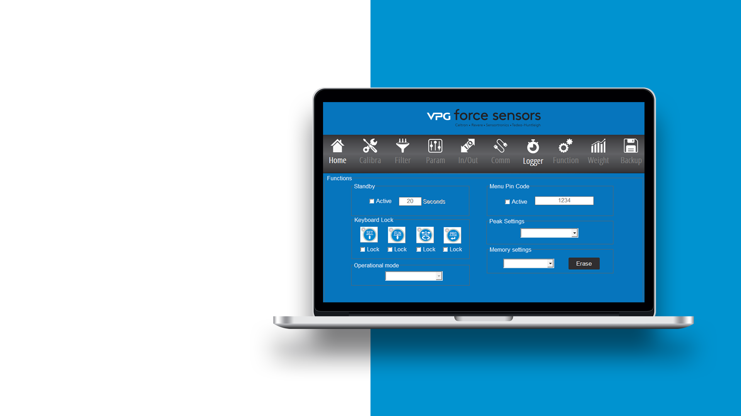
VTW Connect
Intuitive tool for PC-based calibration and monitoring of VPG Weight Transmitters
Easy setup
Fast calibration
Testing – Inputs, logic outputs, analog output
Acquire weight values -- Export to CSV
Data backup & restore – PC file
30 | WT Series Presentation May 2026

Slide 31

Summary
The WT Series delivers real-time transmission and visibility into weighing data, with end-to-end simplicity
Fast data transmission and conversion
Simplified setup, use, & scalability
Versatile connectivity
Proven, reliable performance
Part of a complete, single-vendor solution
31 | WT Series Presentation | May 2026

Slide 32
Learn more
Q&A
Contact a VPG Force Sensors expert to discuss your needs for reliable, real-time transmission of weight data.
Contacts:
vpgfs.americas@vpgsensors.com
vpgfs.asia@vpgsensors.com
vpgfs.emea@vpgsensors.com
32 | WT Series Presentation May 2026

Slide 33


